Slide 1
Supporting mental health and well being at home

Slide 2

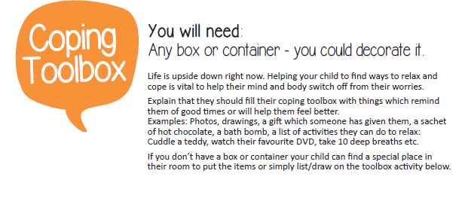
Coping Toolbox
https://www.partnershipforchildren.org.uk/uploads/Files/PDFs/Resilience%20Activities/Coping%20Toolbox.pdf

Slide 3
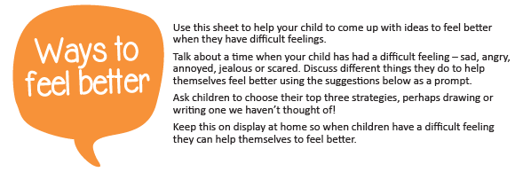
Way to feel better
https://www.partnershipforchildren.org.uk/uploads/Files/PDFs/Resilience%20Activities/Ways%20to%20Feel%20Better.pdf

Slide 4
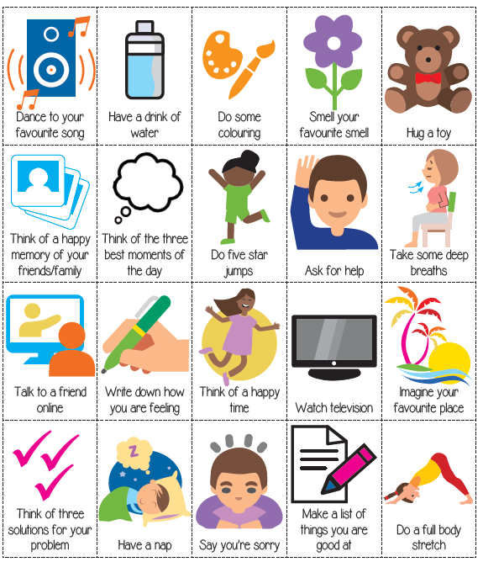

Slide 5
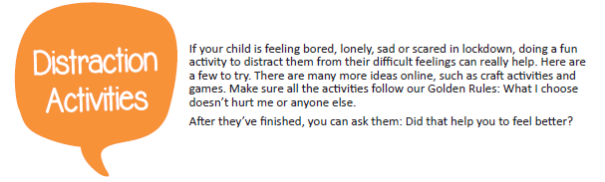
Distraction activities
https://www.partnershipforchildren.org.uk/uploads/images/What%20we%20do/Distraction%20Activities.pdf

Slide 6
