Slide 1
Supporting Mental Health and Well-being at Abbey Court
You may find the following resource useful for supporting you and your child at home:
Resource 1: A resource from Medway Child Health to help think about ways we can look after our mental health and well being (we have added symbols on choice boards to help pupils understand the questions and to make choices).
Resource 2: Instructions on how to make your own sensory calm jar.
Resource 3: A script for a child friendly ‘Guided thinking and breathing’ session, which might help calm children before bed (or at other times of the day).
Useful links:
https://www.bbc.co.uk/newsround/47243692 - A short Newsround clip on Mindfulness and why its important.
https://www.bbc.co.uk/iplayer/episode/m000jdtc/inside-our-home-a-poem - A video and poem about staying home and the positive elements of this.
https://www.bbc.co.uk/newsround/47243693 A video of ‘top tips’ for mindfulness, including making a ‘calm box’
Please also note the following support services are available, should you need them:
Kent and Medway Children and Young Peoples Wellbeing and Mental Health Services and All-age Eating Disorder Service.
Helpline numbers: Out of Hours Mental Health 0300 555 1000 (MHD Line) In Hours Mental Health 0300123 4496 (Kent SPA) or 0300 300 1981 (Medway SPA) Kent & Medway All-age Eating Disorders Service: 0300 300 1980
Young Minds charity provides advice to help young people cope with the changes due to Coronavirus. https://youngminds.org.uk/find-help/looking-after-yourself/coronavirus-and-mentalhealth/ There is also a parent’s helpline: 0808-802-5544

Slide 2
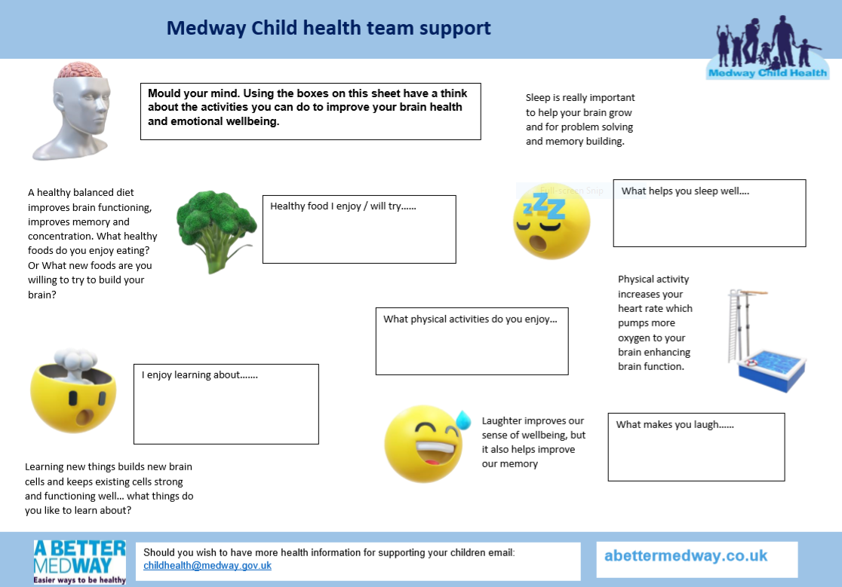

Slide 3
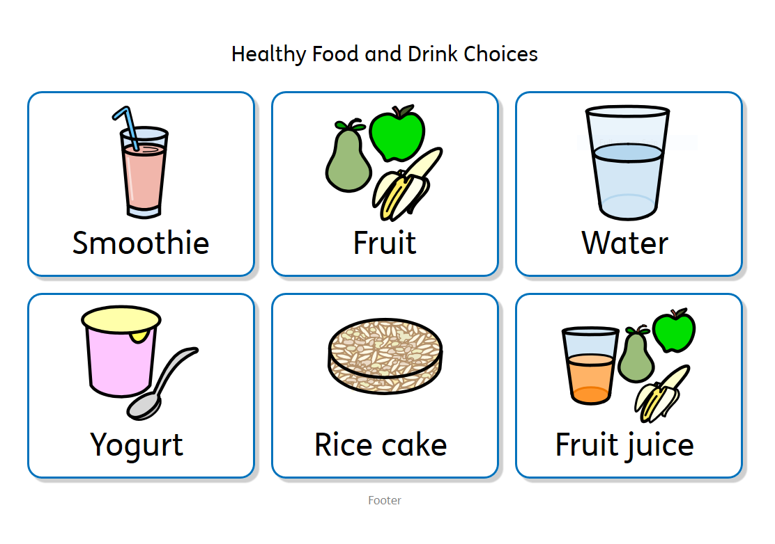

Slide 4
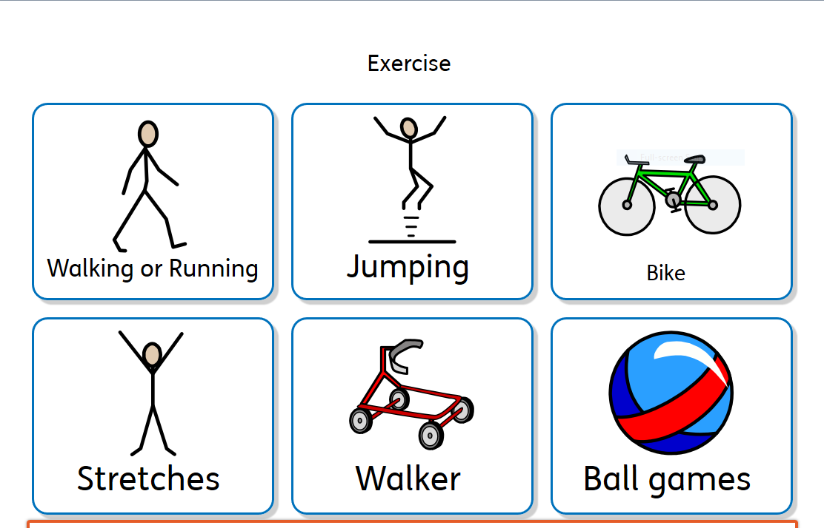

Slide 5
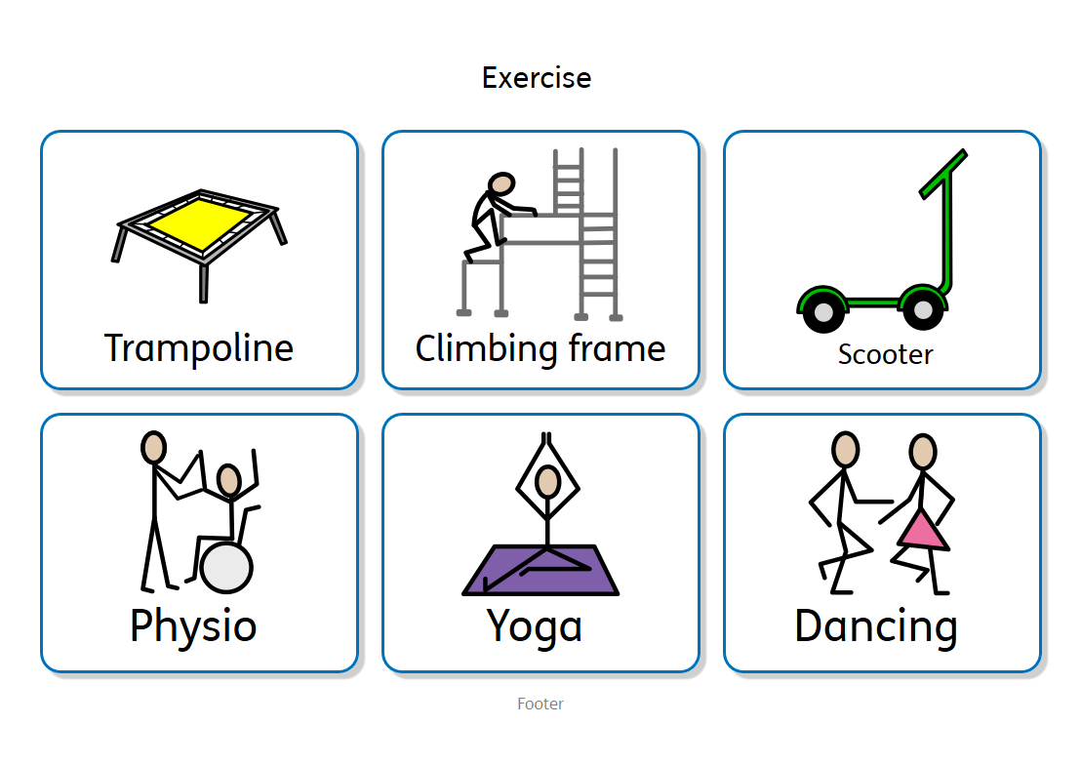

Slide 6
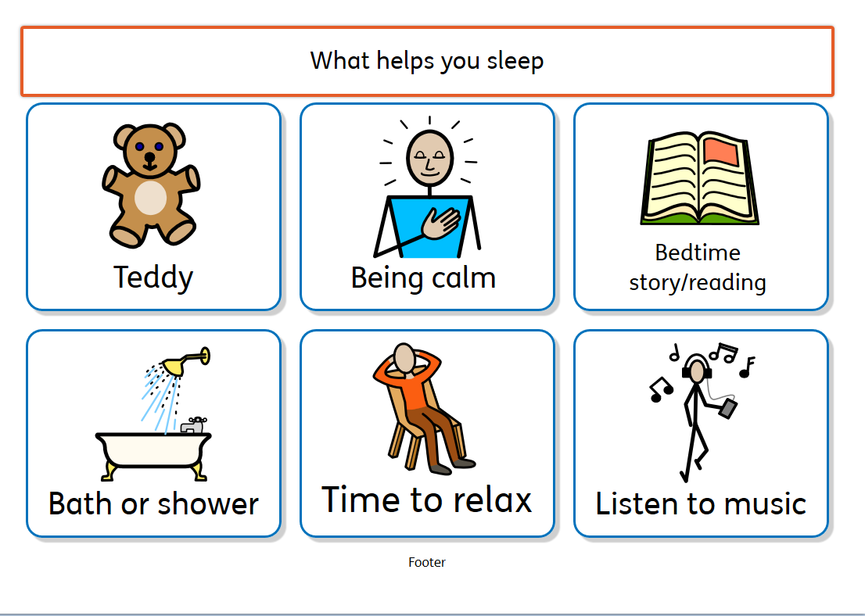

Slide 7
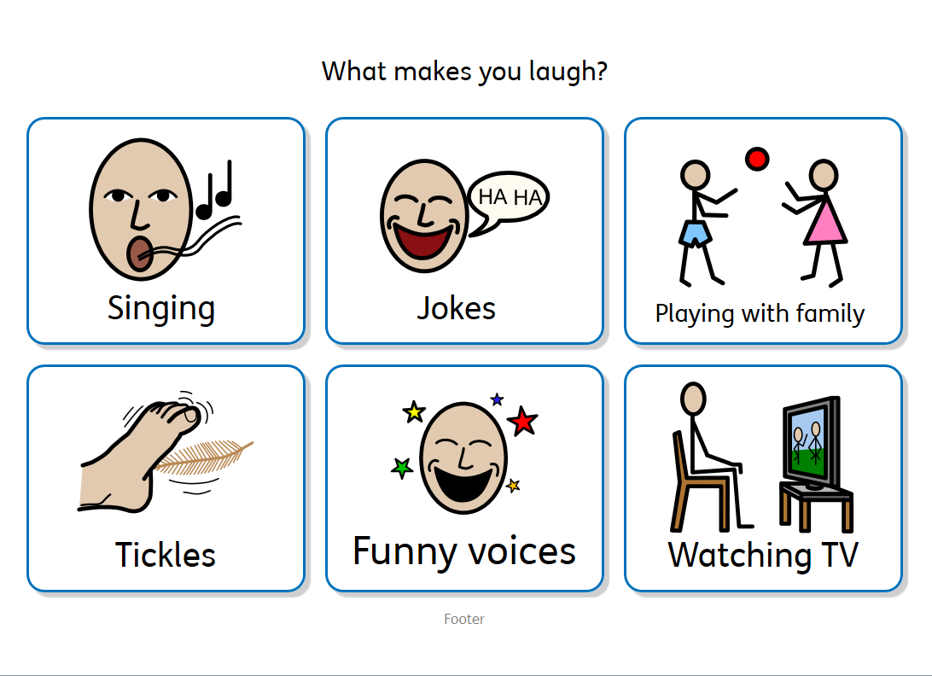

Slide 8
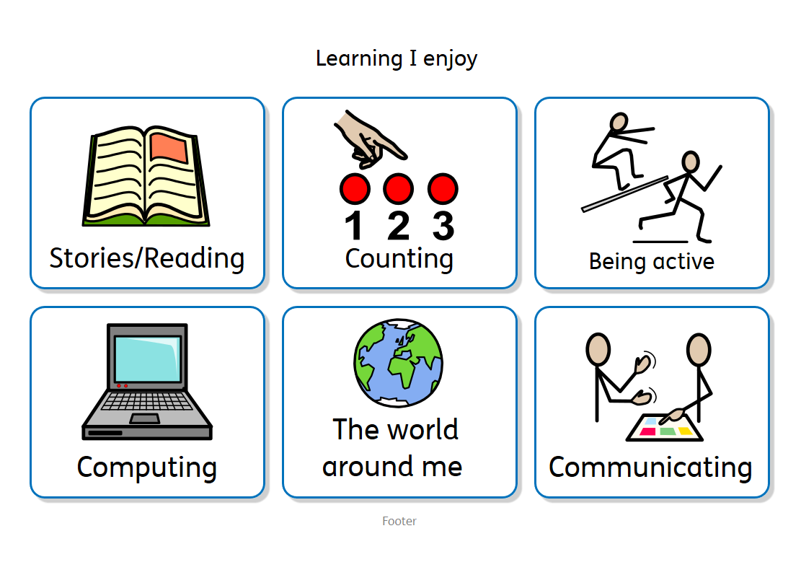

Slide 9
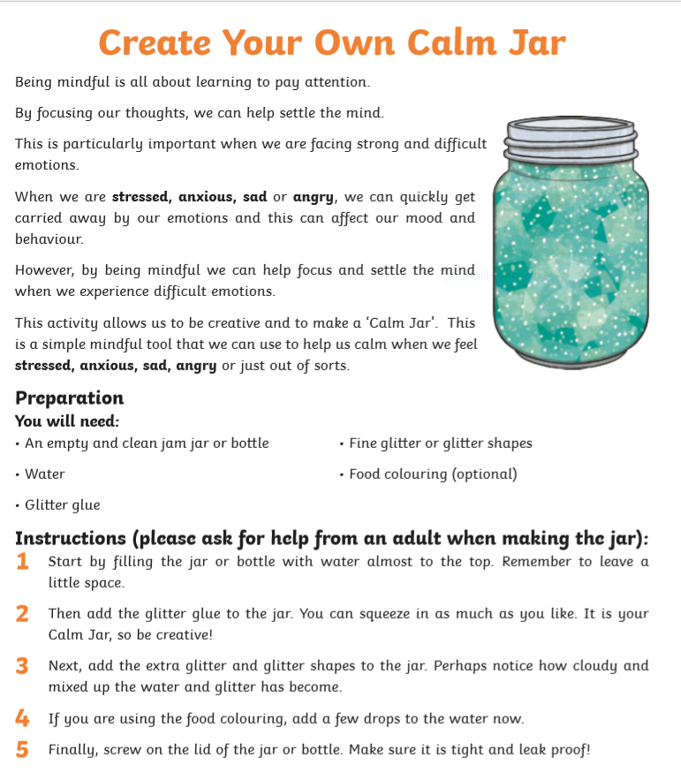
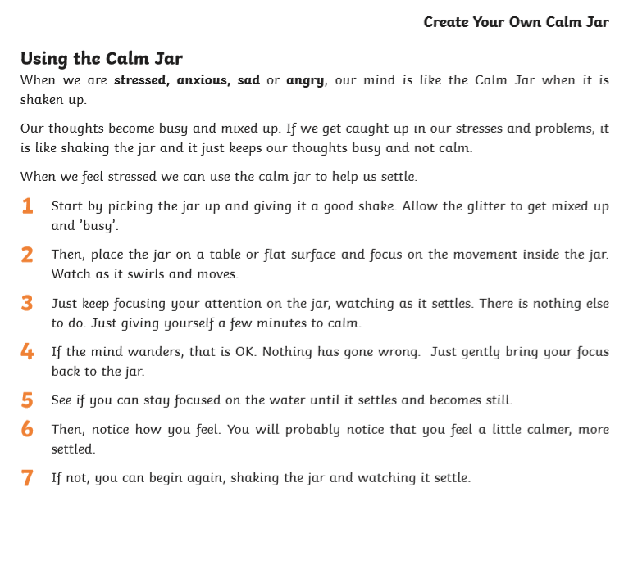

Slide 10
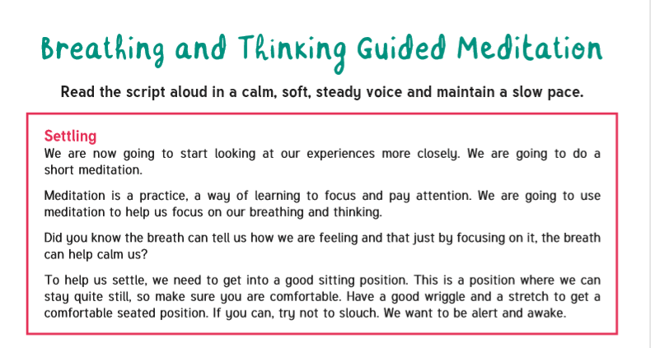

Slide 11
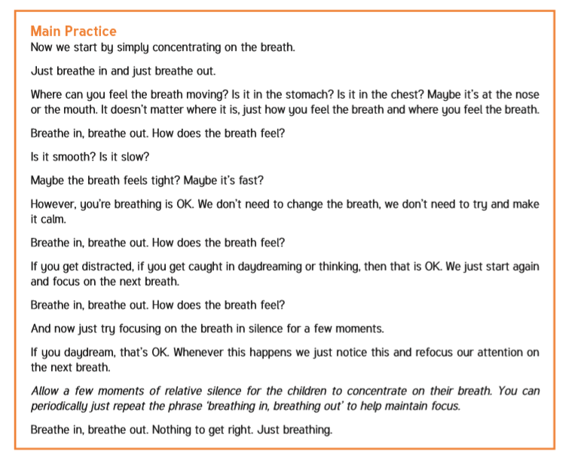

Slide 12
