Slide 2

Resources For You To Use At Home
Monster Mood cards: To help pupils identify how they are feeling and for parents/carers to use to model and raise awareness of different emotions (Slides 3-5)
How am I feeling today?: An alternative chart to support pupils to identify feelings (Slide 6)
Calm cards: A range of activities designed to support pupils to relax and feel calm. These can also be used as choice cards for pupils to decide on their own calming activities (Slides 7-9)
Social story: A story to support understanding of the changes pupils may have to their routines (this can be found as a separate attachment on the website in the ‘Mental health and Well-being’ section)
How to make a Worry Monster: With support from an adult, some pupils may like to make their own Worry Monster and be supported to communicate and talk about any worries they might have. (Slide 10)

Slide 3
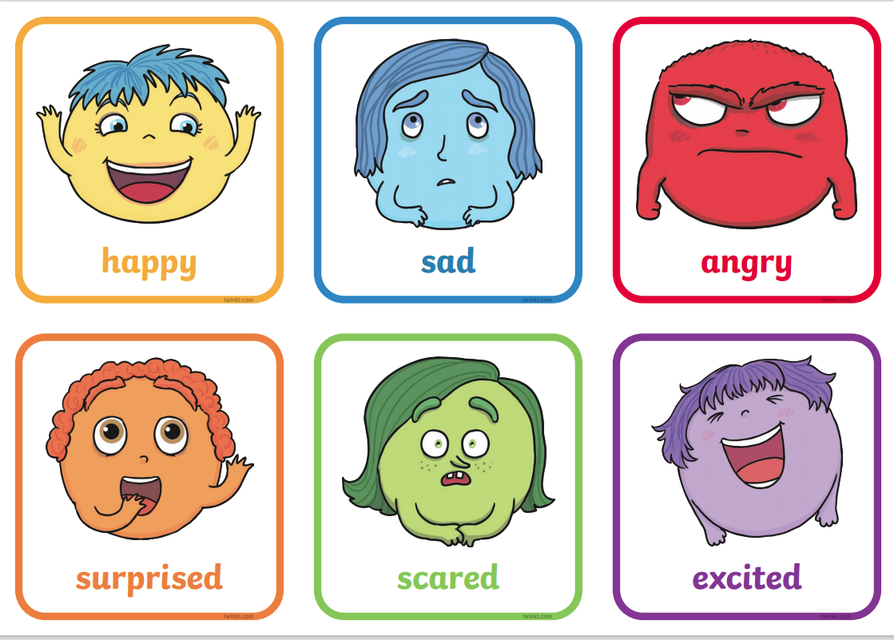

Slide 4
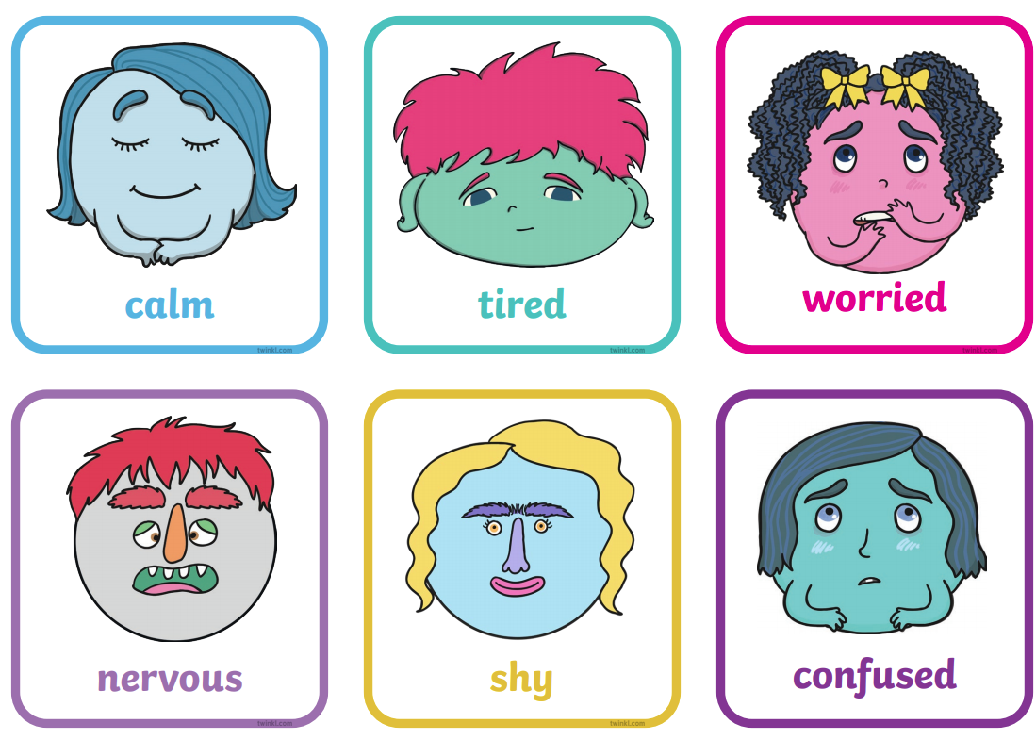

Slide 5
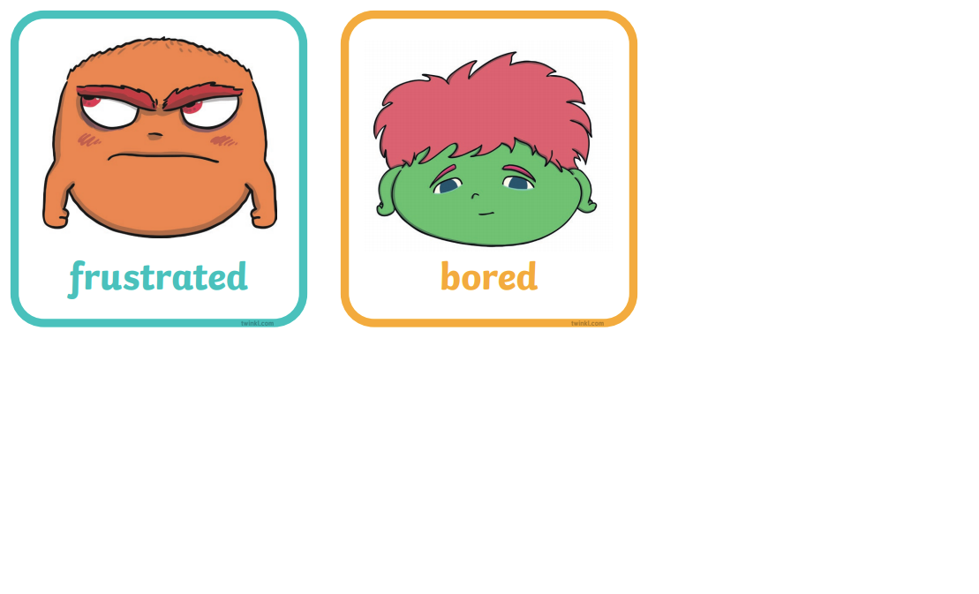

Slide 6
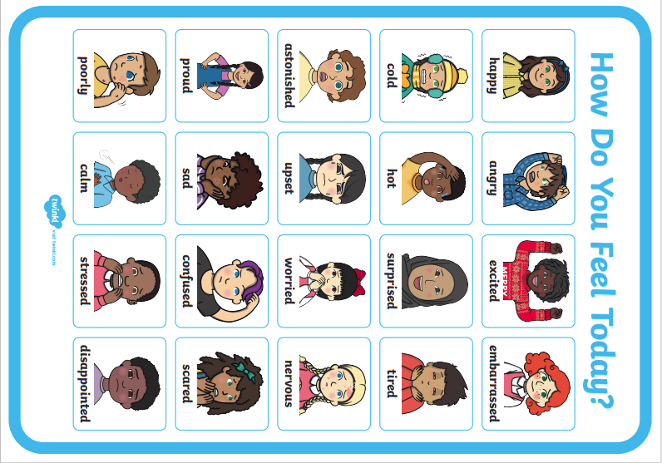

Slide 7
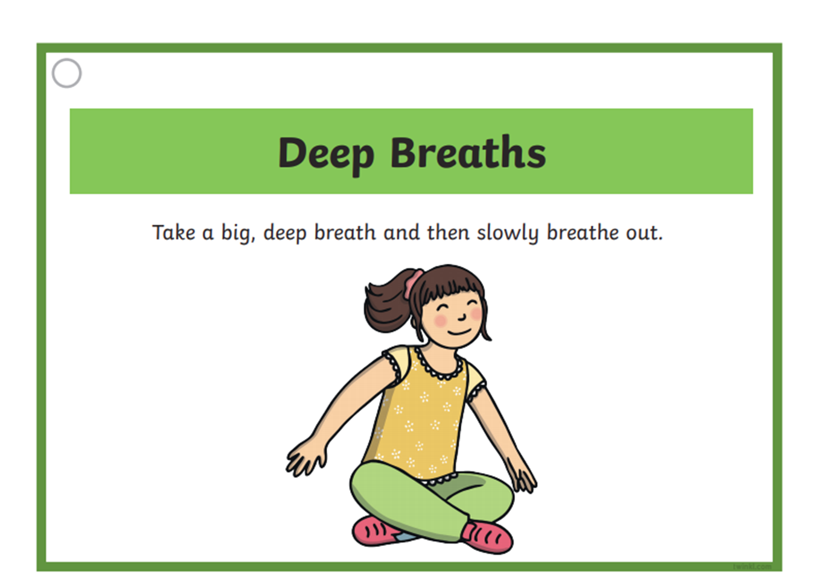
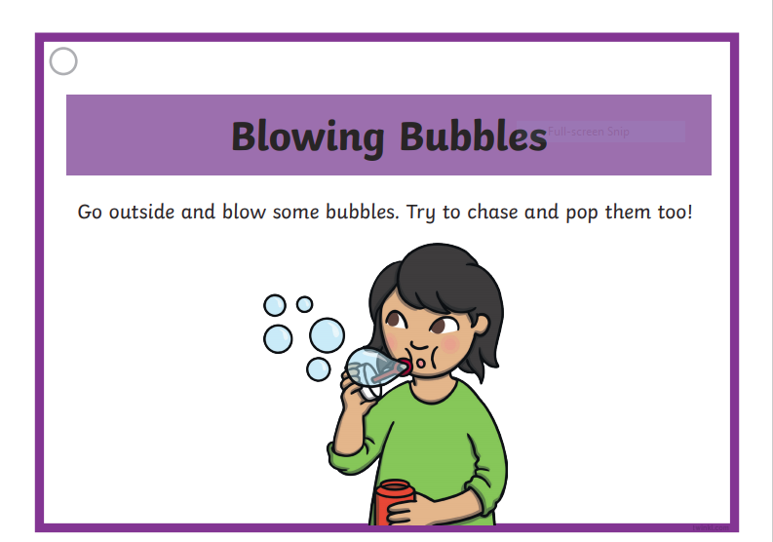
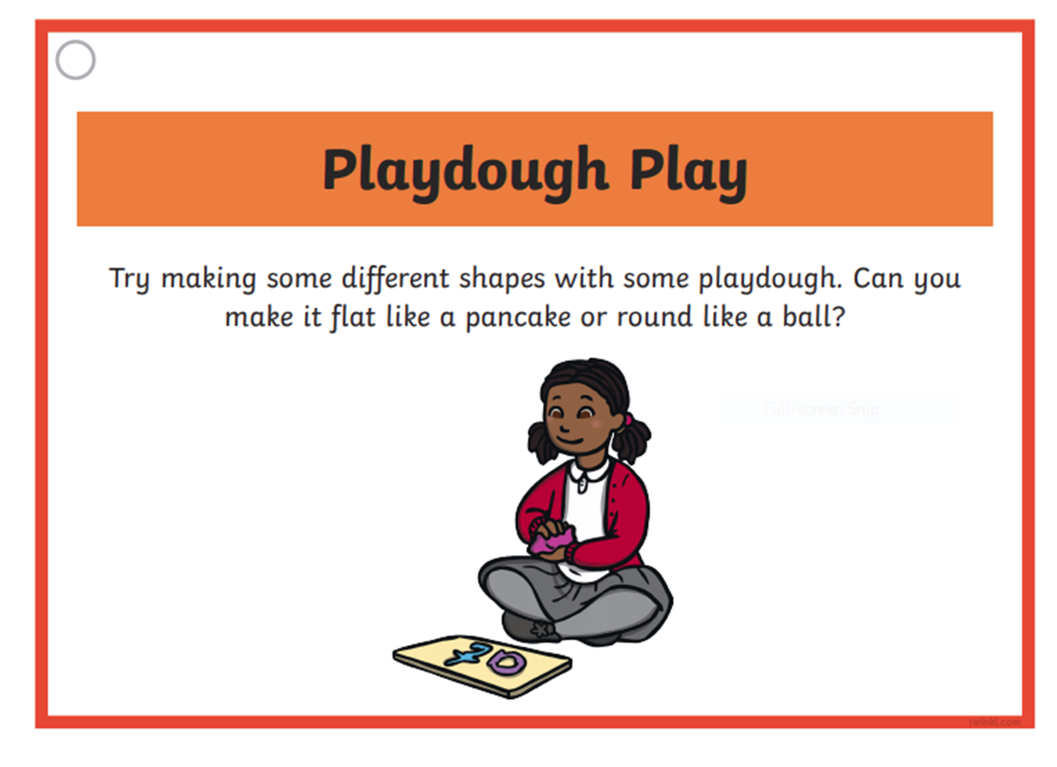
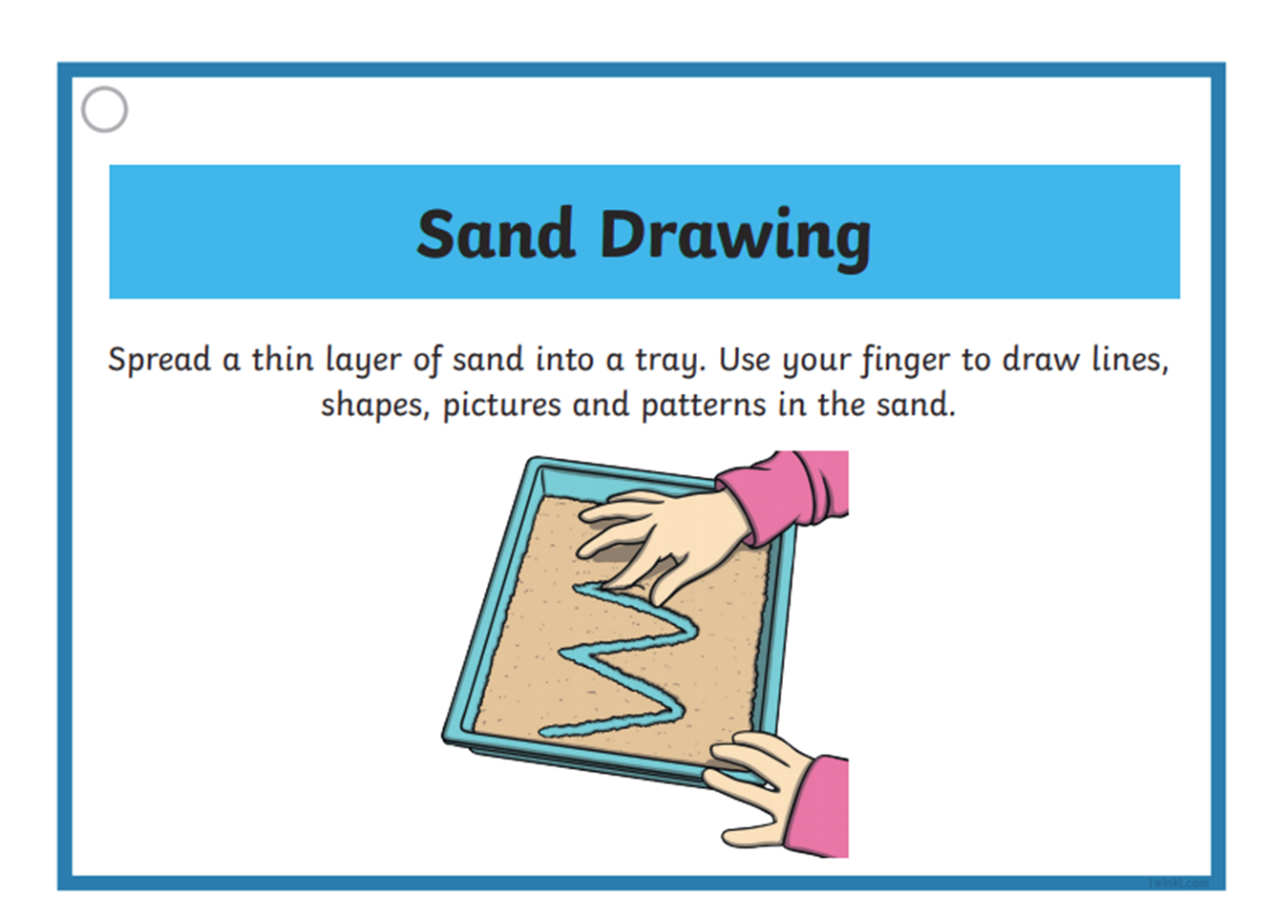

Slide 8
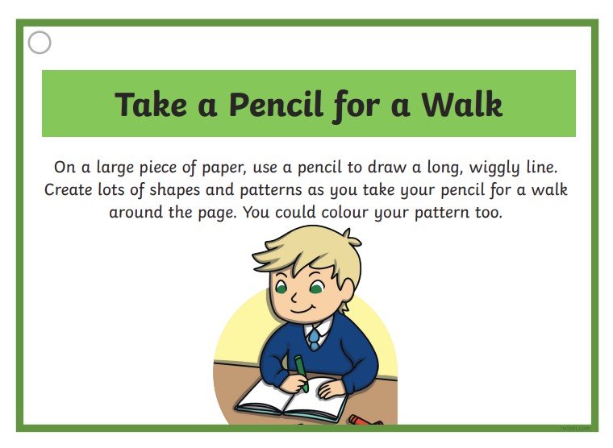
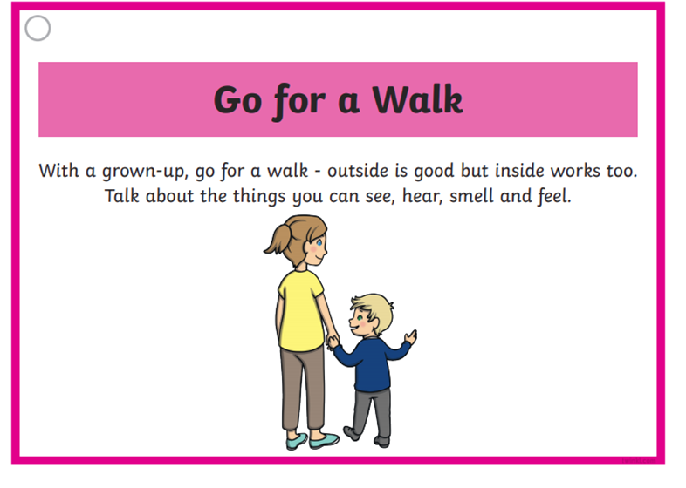
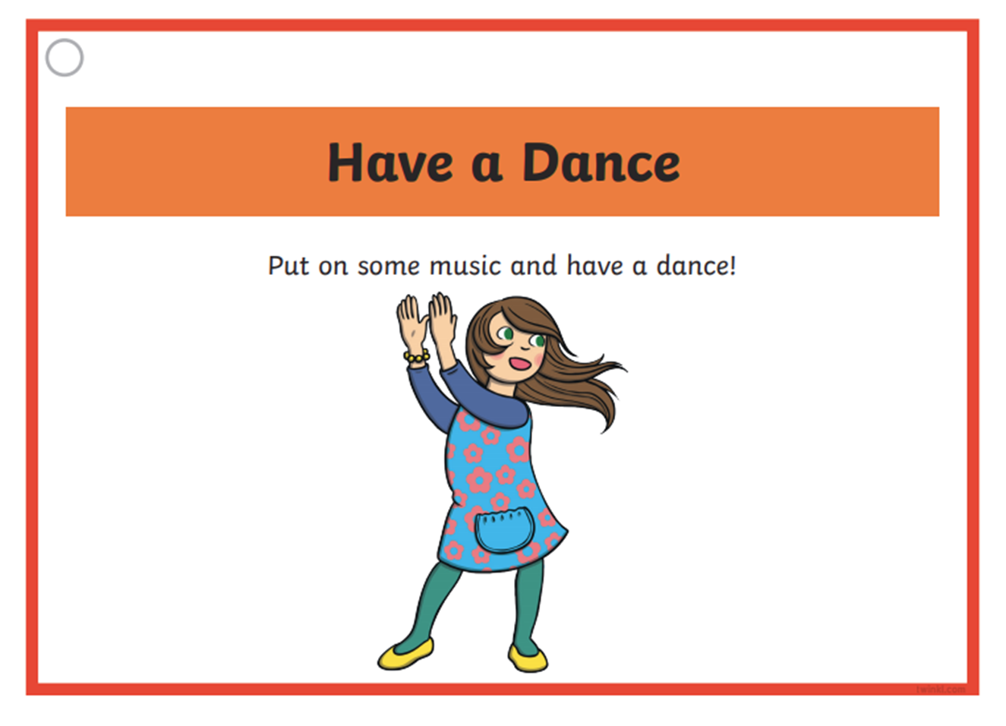
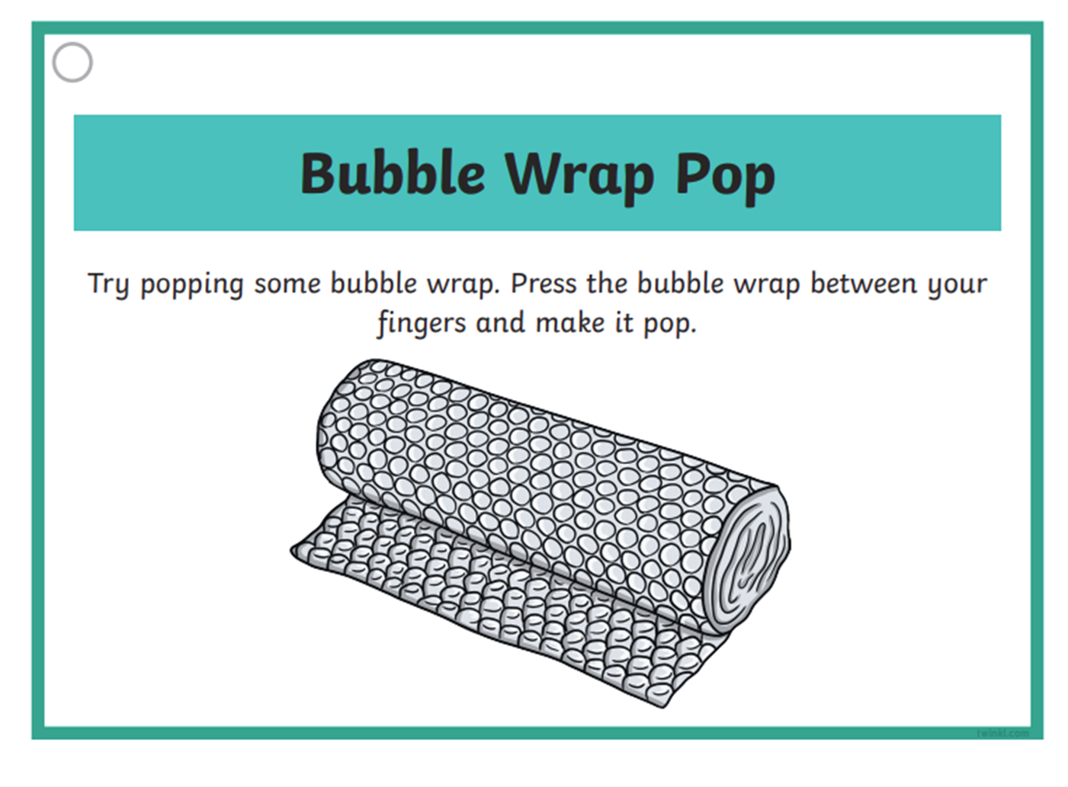

Slide 9
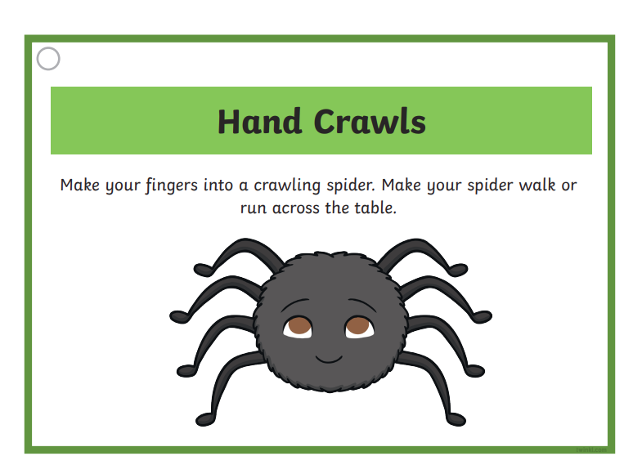
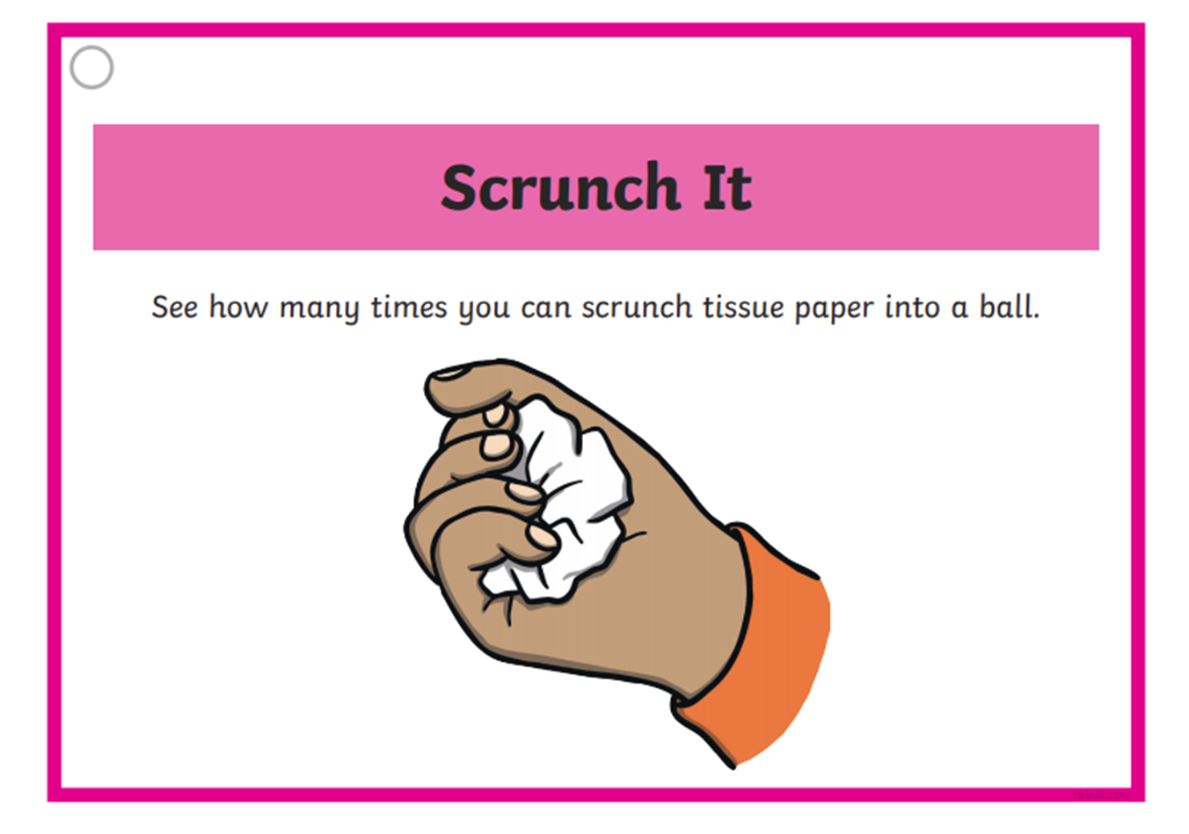

Slide 10
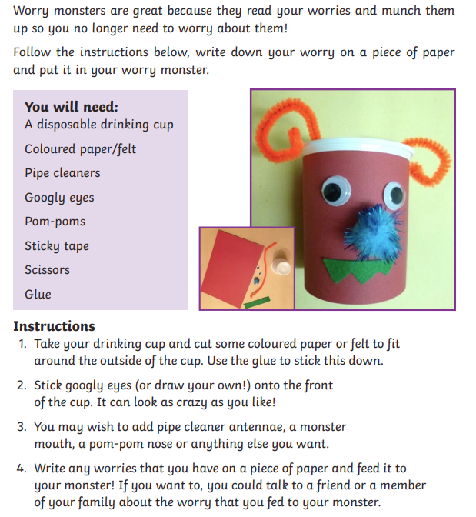
How to make a Worry Monster

